Slide 1
Introduction to TALUS Control
Nathan Daniel, F2017

Slide 2
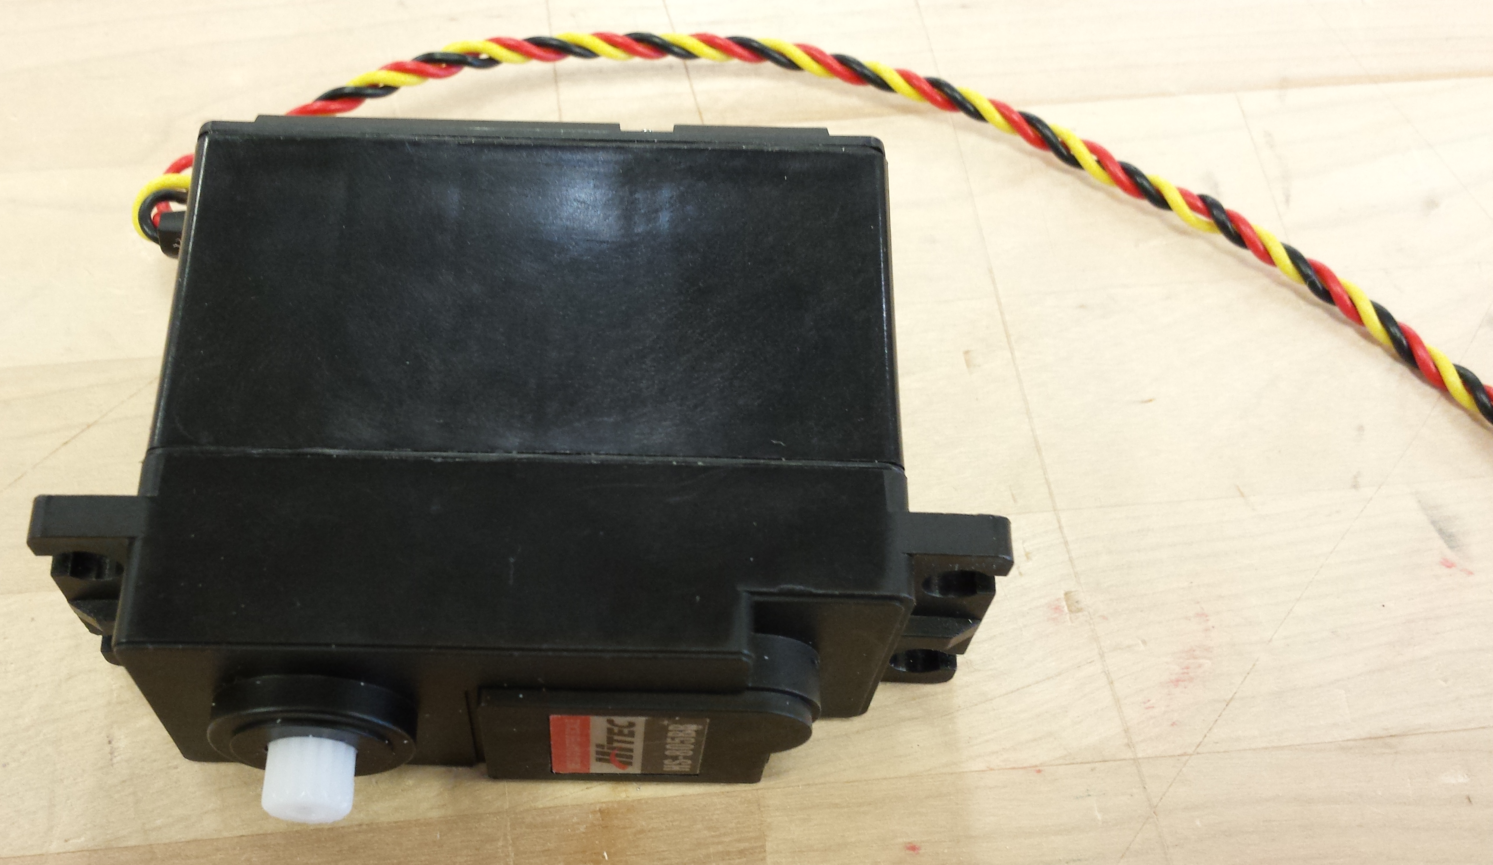
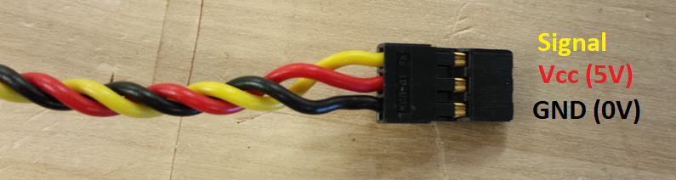

Slide 3
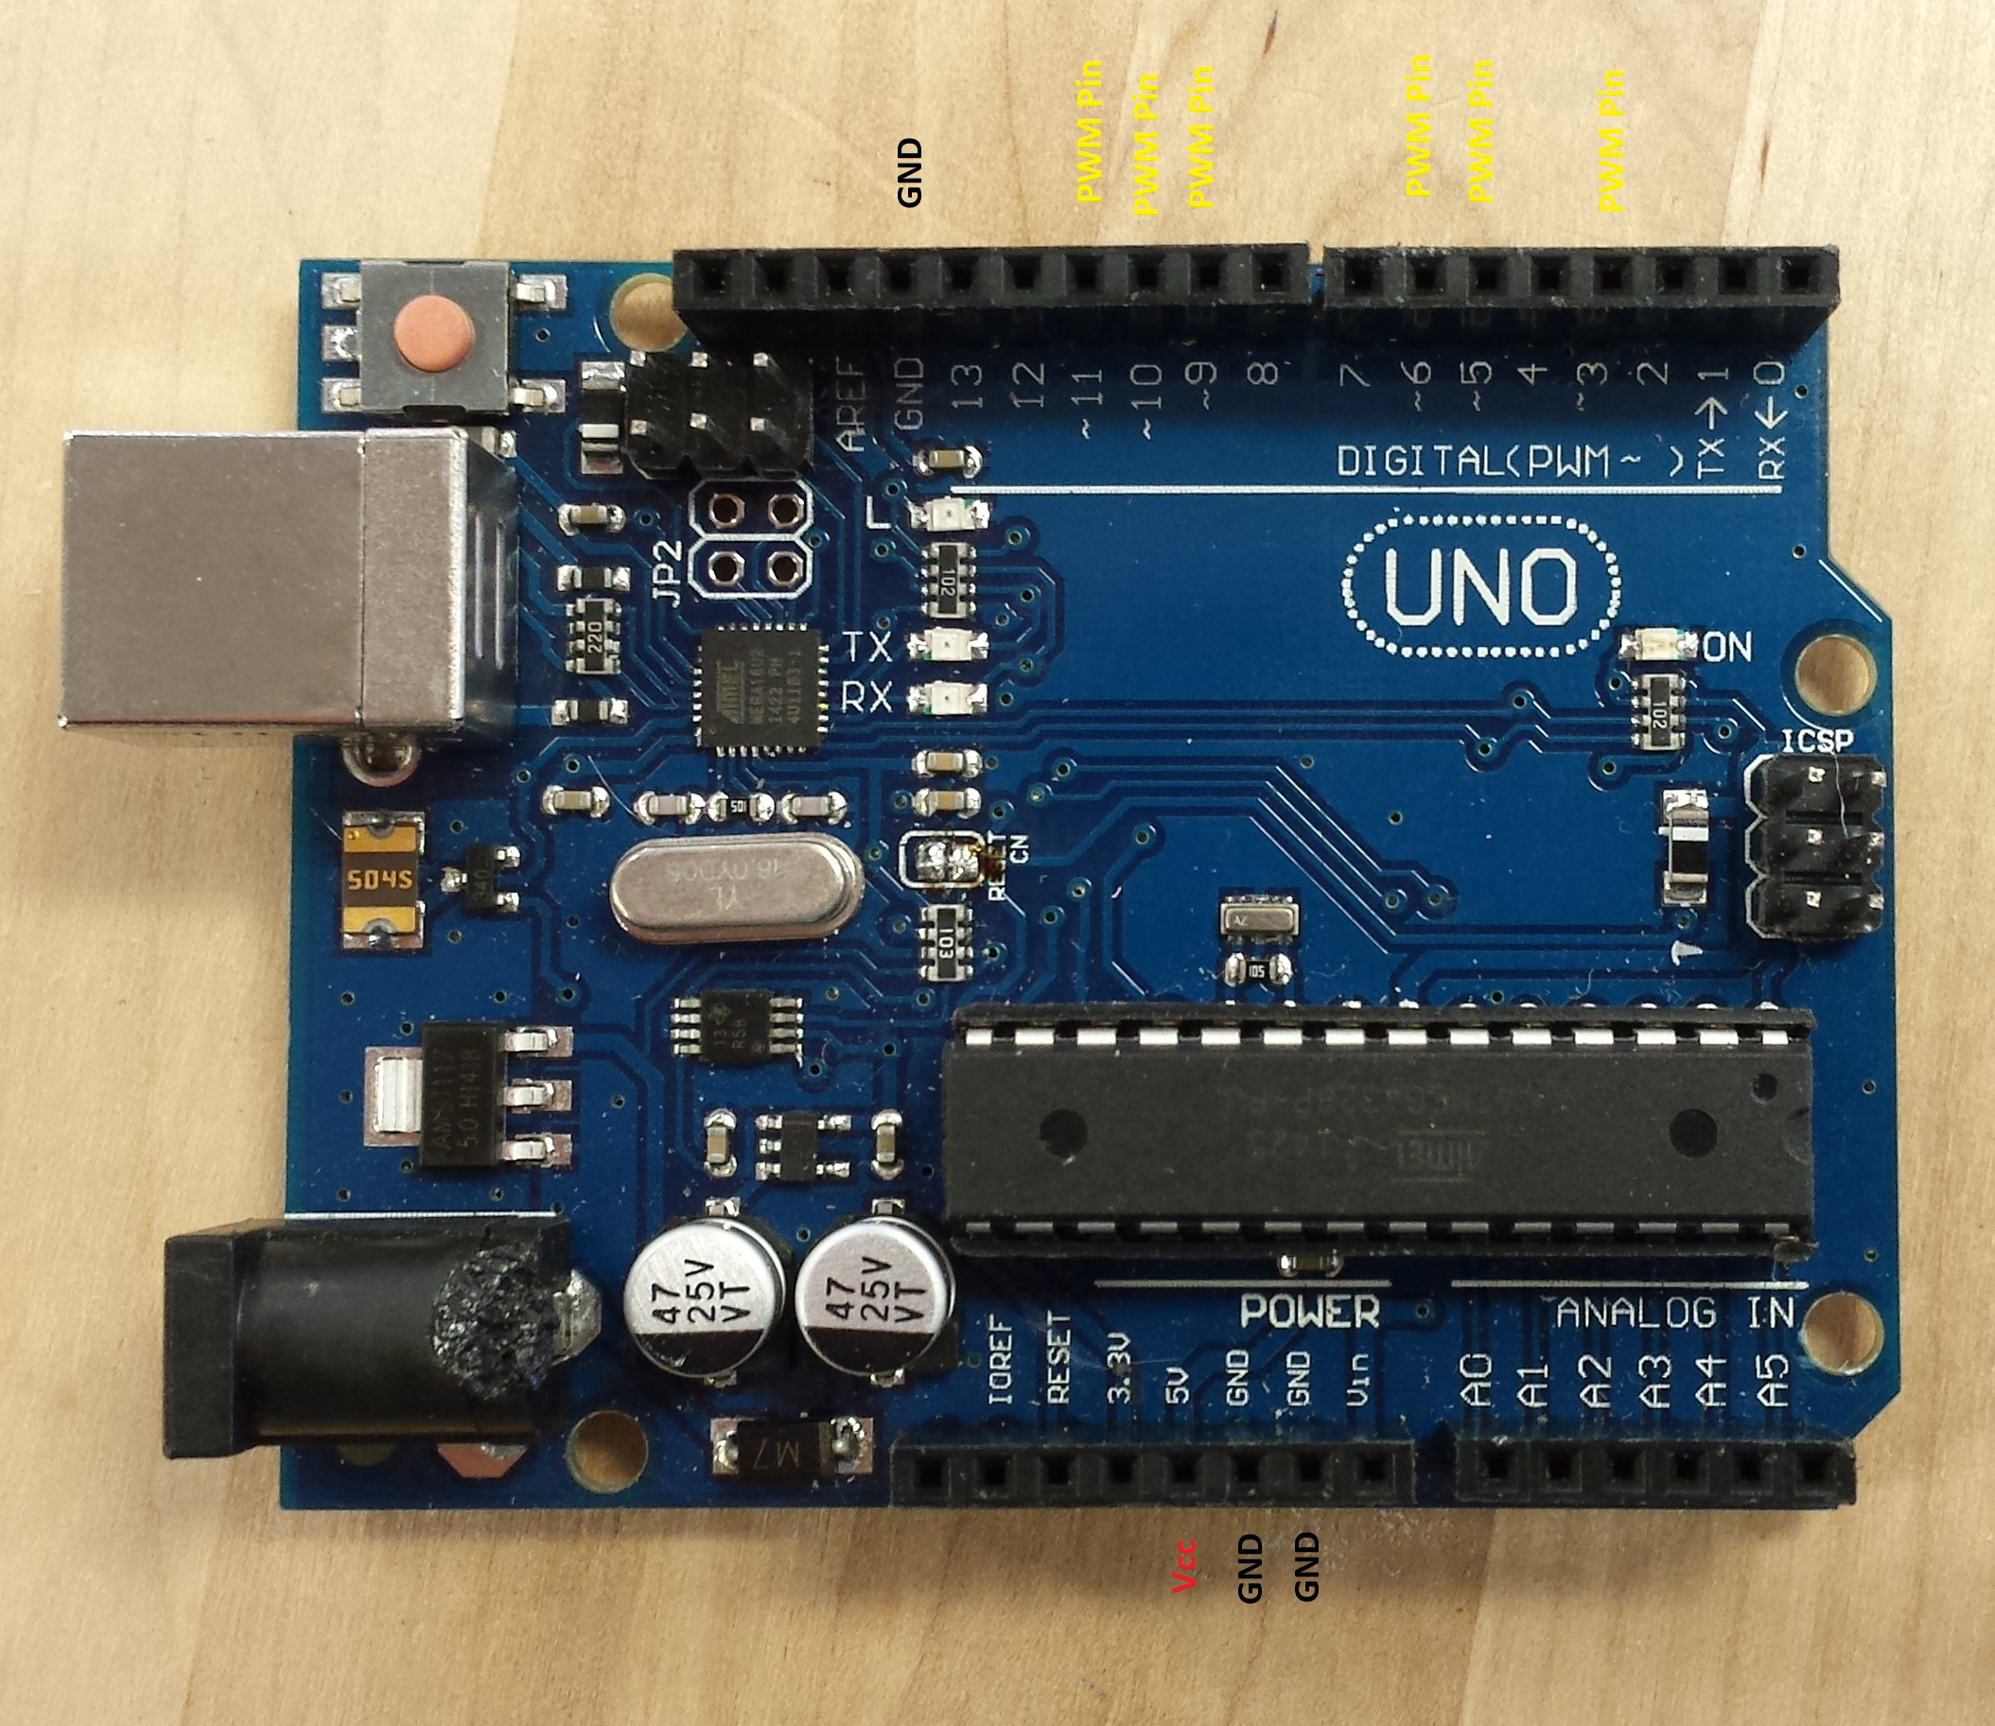

Slide 4
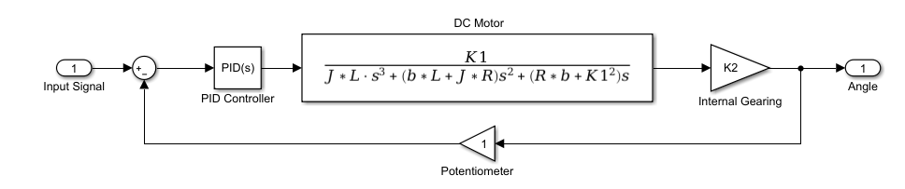
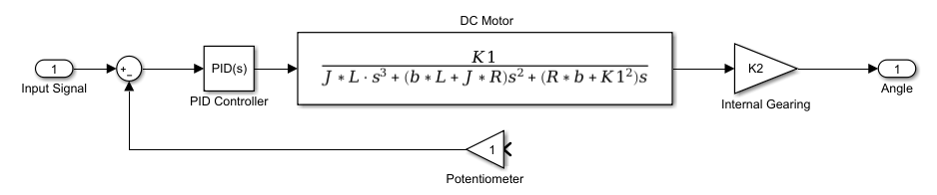
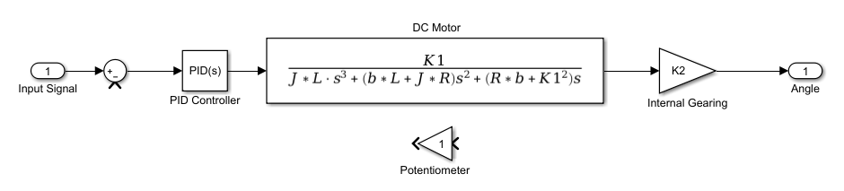
1. Remove potentiometer from servo
2. Cut wires from potentiometer to control board

Slide 5
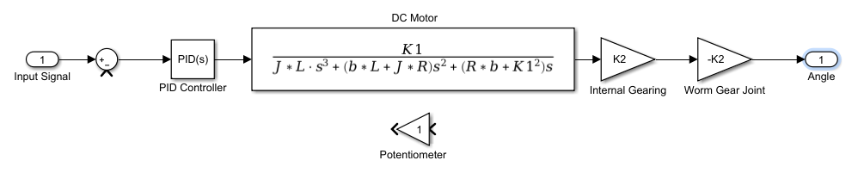
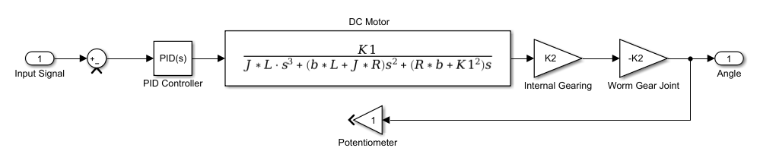
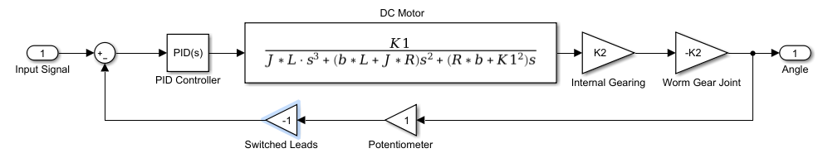
3. Attach servo to robot frame
4. Attach potentiometer to robot frame
5. Re-solder potentiometer to servo, switching order of leads

Slide 6
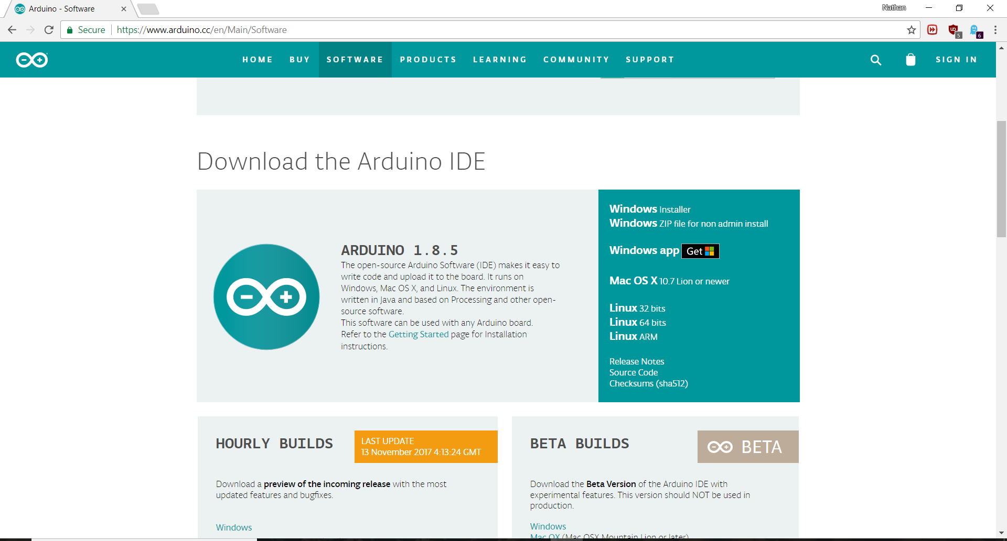

Slide 7
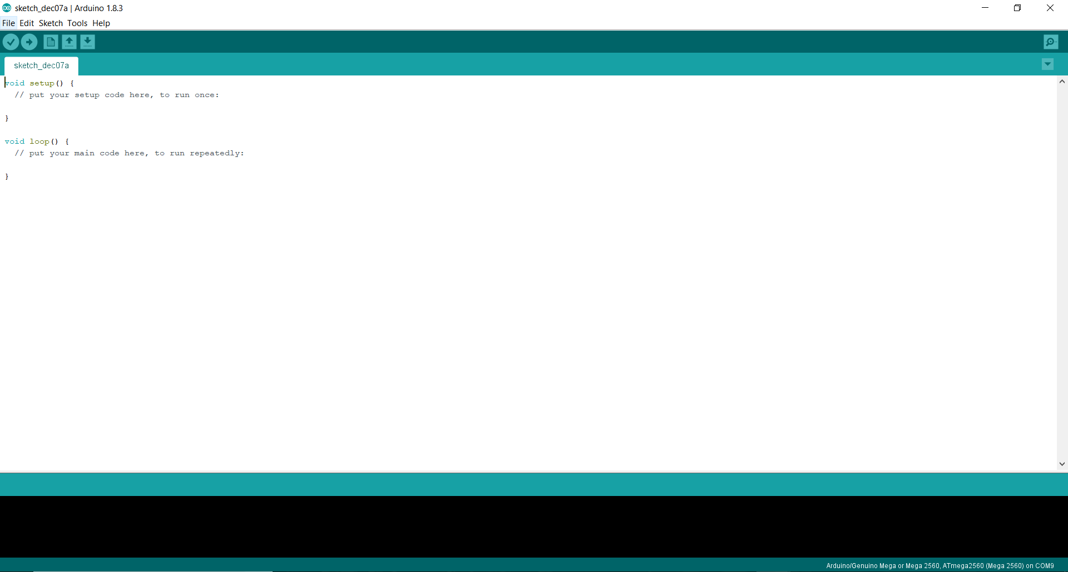

Slide 8
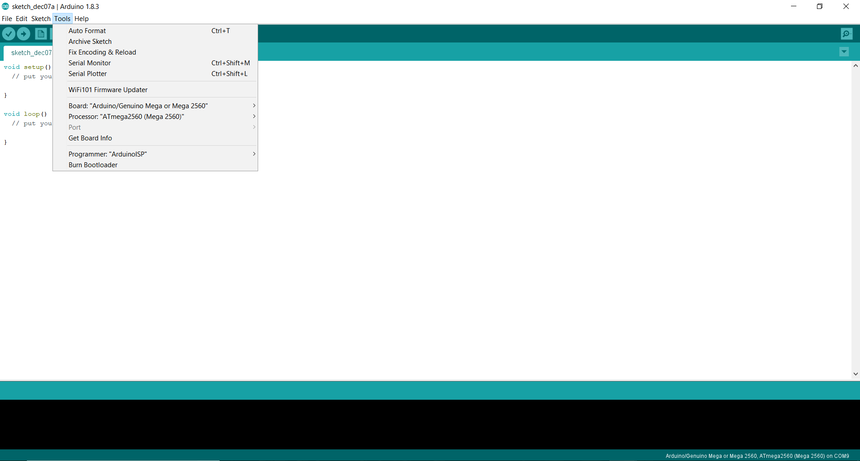
Board: Depends on what you are programming (we have Duemillanovas (Dues [Dew-ays]), Unos, and Megas)
Port: Select after you plug the board in (for Dues, look online for how to install a designated COM port)
Programmer: ArduinoISP

Slide 9
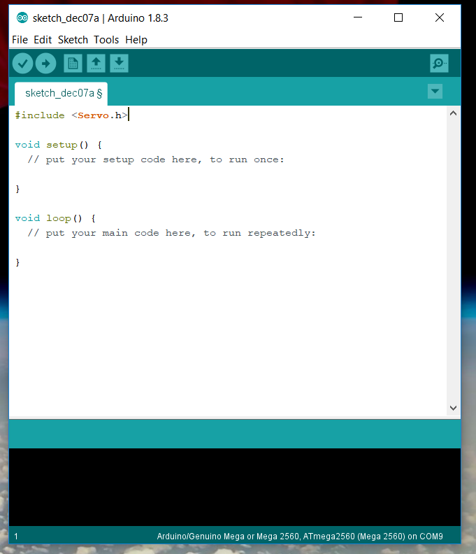
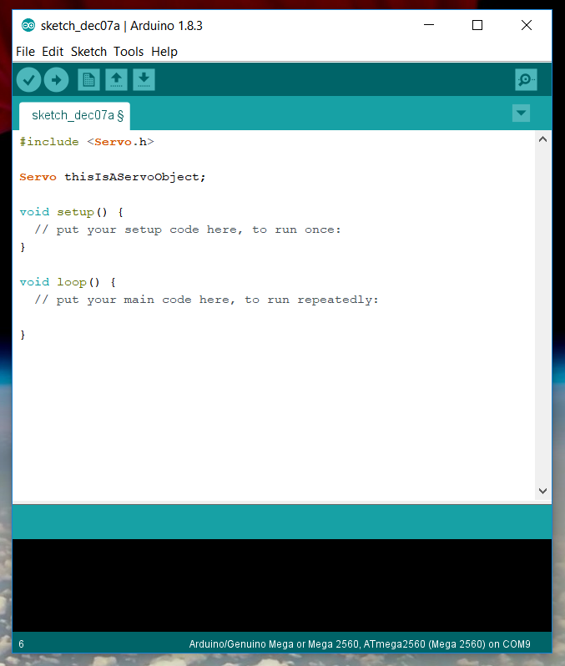
1. #include <Servo.h>: includes servo code library
2. Servo thisIsAServoObject: declares a servo object (characteristics defined in the servo library)

Slide 10
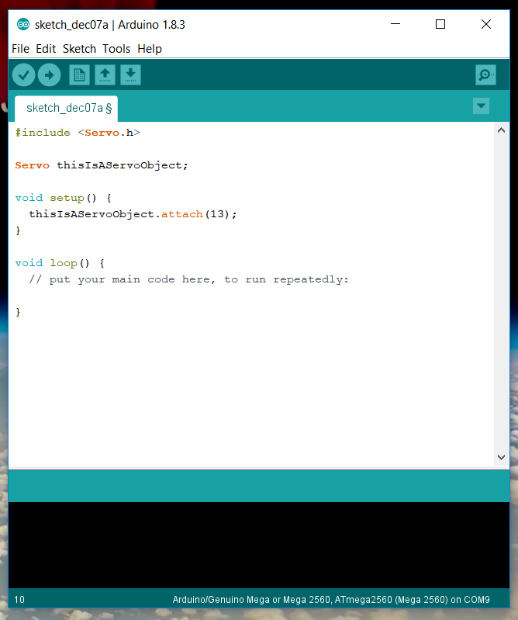
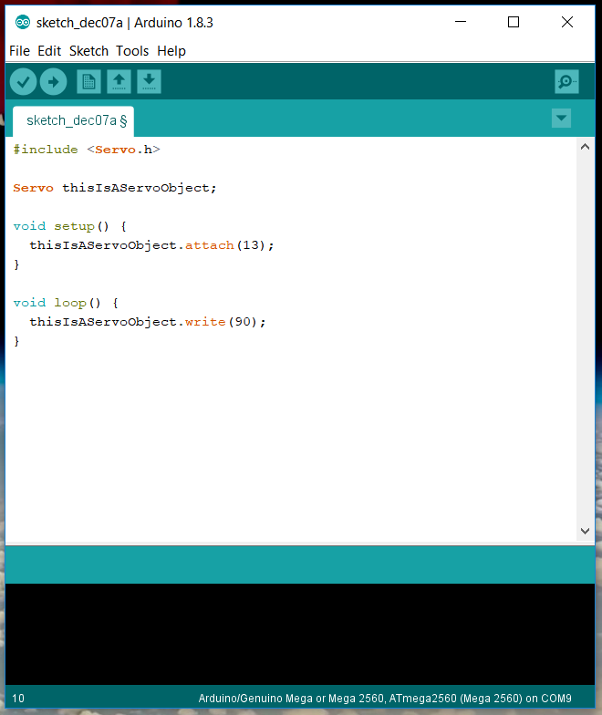
3. thisIsAServoObject.attach(13): attaches the servo object to digital pin 13
4. thisIsAServoObject.write(90): tells the servo on pin 13 to move to 90 degrees

Slide 11
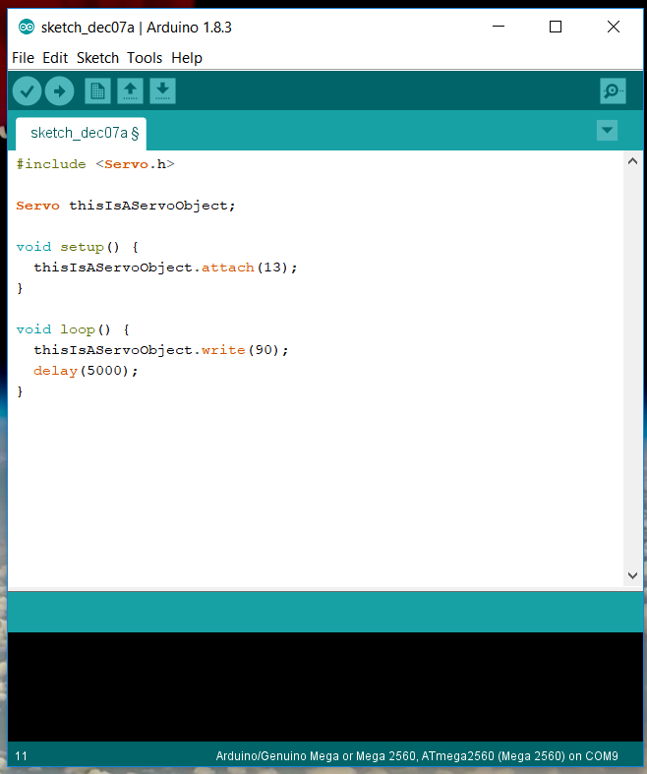
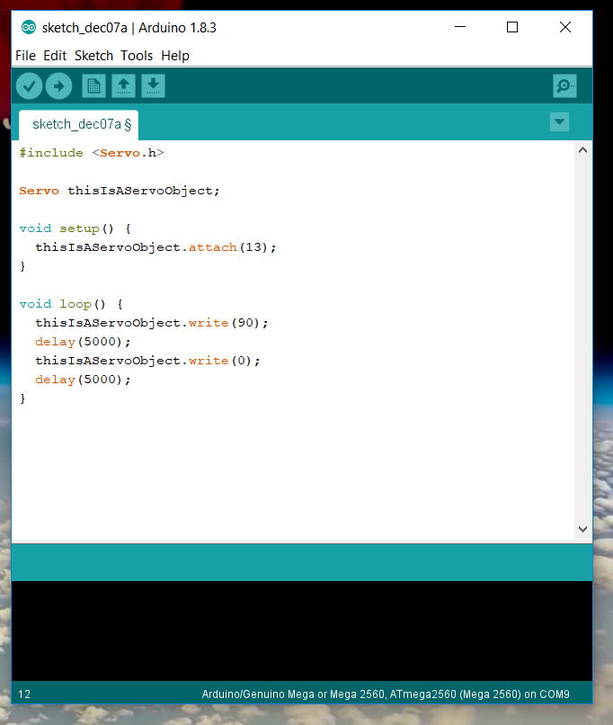
5. delay(5000): delays for 5000 milliseconds after the previous command
6. Repeat previous commands to move back to 0 degrees and wait another 5000 milliseconds

Slide 12
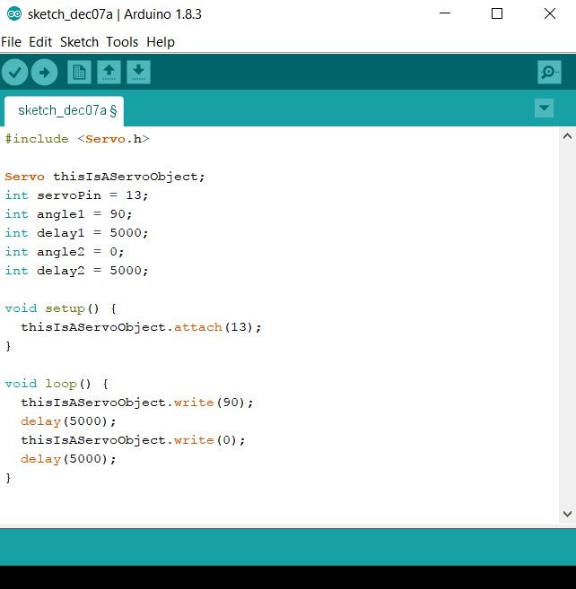
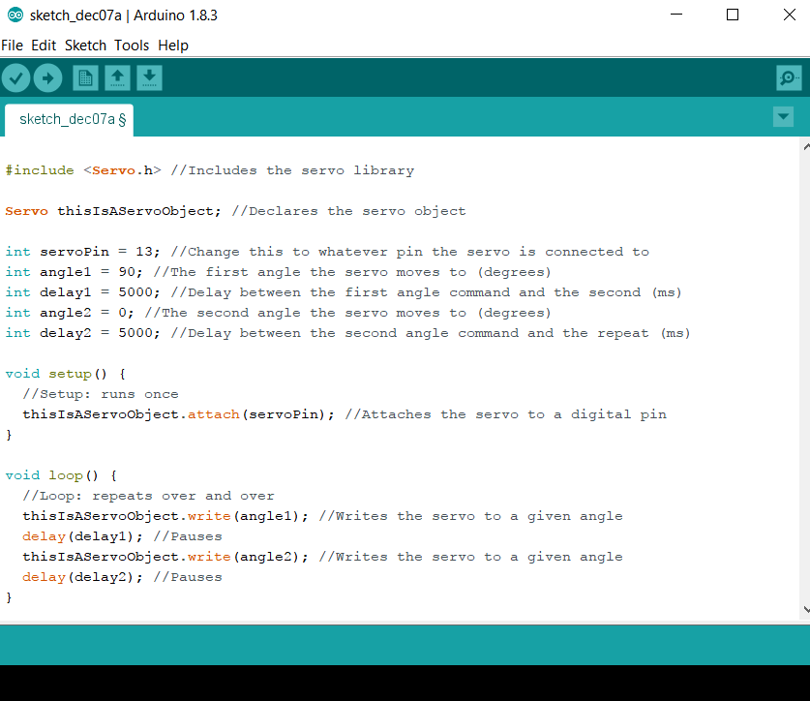
7. Put variables at top to make it easily adjustable for different tests
8. Add comments to make code readable

